Slide 1
Module 10 - Authentication, Session Management & Notifications

Slide 2
Learning Objectives
Content:
Backend authentication
Token-based login (JWT)
Sessions & secure token storage
Login + Signup flow
Auto-login & logout
Protected routes
Introduction to Firebase Auth
Notifications after authentication (Local Notification)
Notes:
Explain that this module unlocks real-world app development.

Slide 3
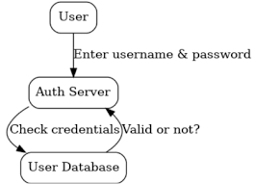
What is Authentication?
Authentication = verifying who the user is.
Used to:
Protect user accounts
Allow personalized features
Control access to private data
Authentication vs Authorization
Authentication → Who are you?
Authorization → What are you allowed to do?
Use real examples:
Shopee, GrabFood, Tiki.
Notes:
Give examples: order history, payment info → requires login.

Slide 4
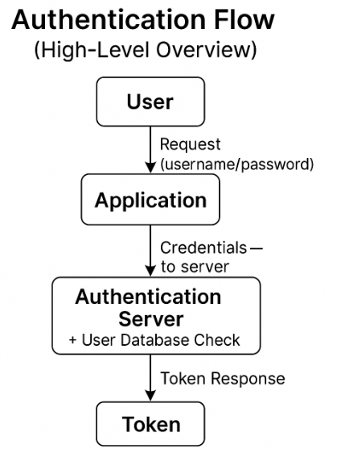
Authentication Flow (High-Level)
User enters credentials
App sends API request
Backend verifies
Backend returns token (JWT)
App stores token locally
App uses token on every API request
Session maintained until logout or token expires
Notes:
Mention that this is the exact sequence used by REST APIs.

Slide 5
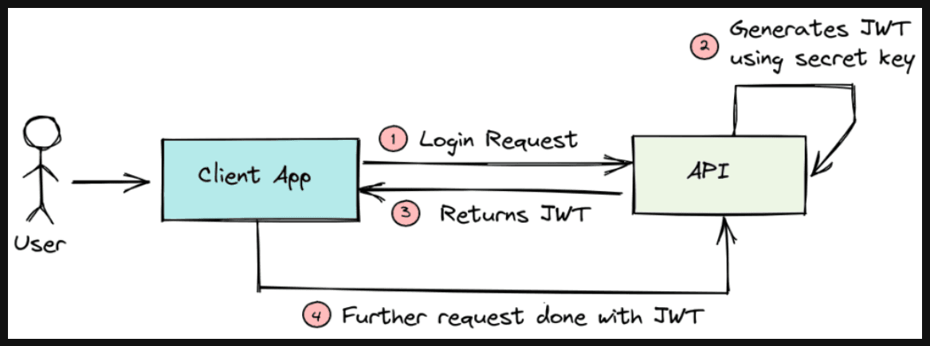
Token-Based Authentication
What is a token?
A token is a short-lived digital credential generated by the server to prove a user’s identity.
Benefits
Stateless
Secure
Works across mobile/web
Fast
Types
Access tokens
Refresh tokens
Token Flow Diagram (Recommended)
User sends username/password → server checks
Server returns Access Token + Refresh Token
Application sends Access Token in each request
When Access Token expires → send Refresh Token to get new
Notes:
Token ≠ password, so App doesn't secure password.
Access Token is shortened to reduce exposure risk.
Refresh Token has strong permissions → must be stored securely (Secure Storage).
Explain to students that Flutter doesn't need to "understand the token" — just store the token and send it in the header:

Slide 6
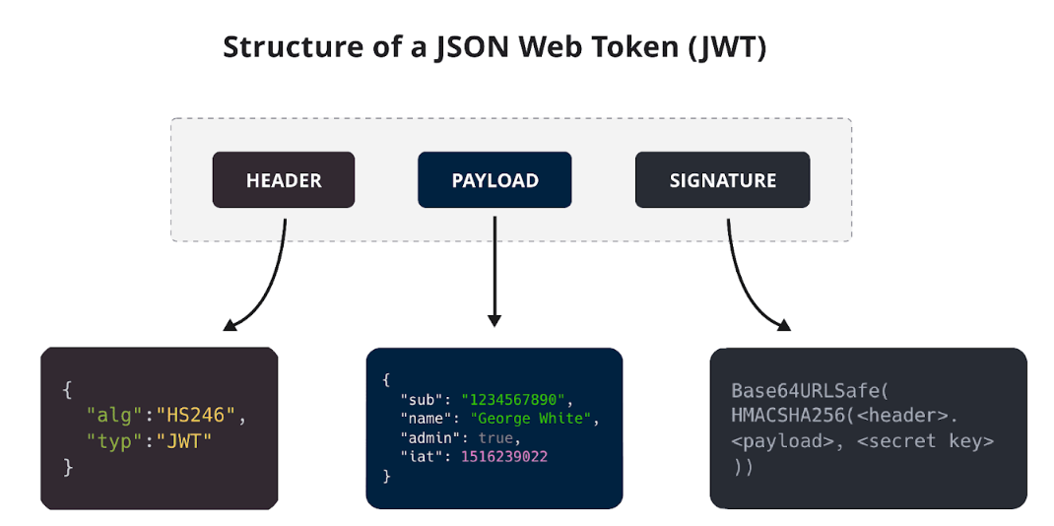
JWT (JSON Web Token) Explained
Structure of a JWT:
Header (algorithm, type)
Payload (user ID, email, role)
Signature (verification)
Properties:
Base64 encoded
Signed (not encrypted)
Has expiry time
Notes:
“JWTs must not store passwords. Only identity claims.”

Slide 7
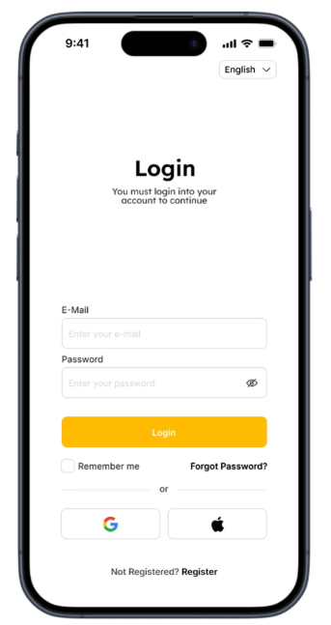
Login Screen UI Structure
Components
Email TextField
Password TextField
Login Button
“Forgot Password?”
Navigation to Signup
Good Practices
Inline field validation
Disable button while loading
Hide/show password
Designing Login Form
Email Field
Type: email
Validator: regex or basic contains '@'
Password Field
obscureText: true
Min 6 characters
Buttons
Primary submit
Secondary link to signup
Notes:
Mention UI spacing, padding, and consistent layout.

Slide 8
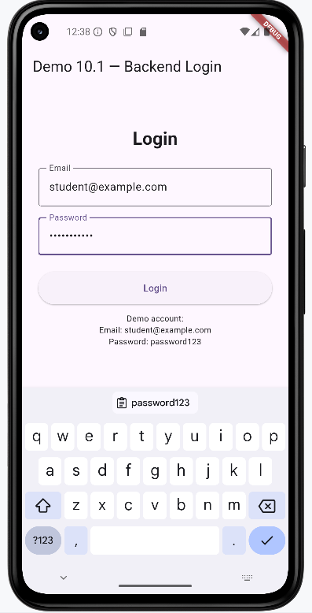
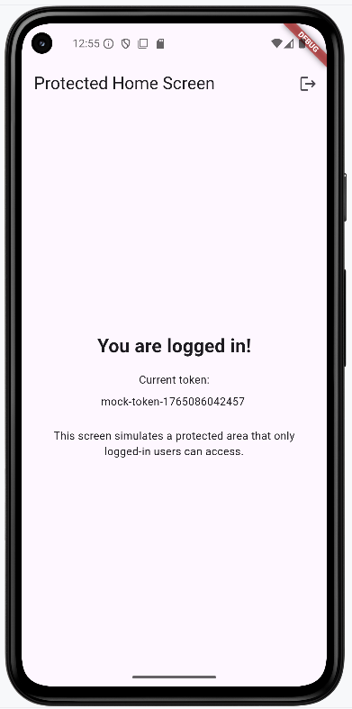
Demo 10.1 - Backend Login Flow (Overview)
Objectives
Build a login screen with email + password fields
Validate inputs using Flutter Form
Simulate backend authentication
Receive & store a mock token
Navigate to a protected screen
Step-by-Step Flow
Step 1 — Build UI
Step 2 — Simulate backend request
Step 3 — Handle mock response
Step 4 — Navigate to protected screen

Slide 9
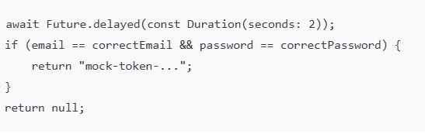
Step 2 - Simulated Authentication Request
Because public API services may fail or block emulators,
Demo 10.1 uses a mock backend inside AuthService.
What Happens Here?
The app pretends to send credentials to a server
Adds a 2-second delay to mimic real network latency
Checks if email/password match the demo account
Returns a mock JWT token when valid
Code Snippet
Notes:
This slide replaces the http.post version, but the flow is identical to real backend authentication.

Slide 10
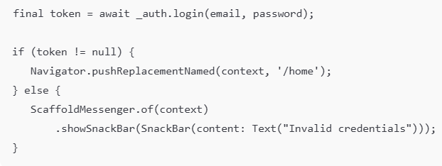
Step 3 - Authentication Result Processing
If credentials are valid
Receive mock token
Save token inside AuthService
Prepare for navigation
If invalid
Return null
Show error Snackbar
Code Snippet

Slide 11
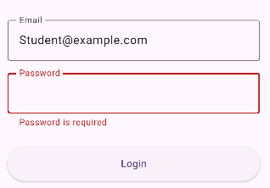
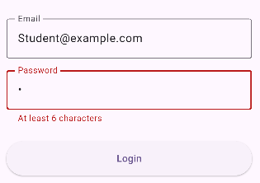
Error Handling (Step 1 + Step 3)
Error & Validation Handling
Client-side Validation (Step 1)
if (!_formKey.currentState!.validate()) return;
Common validation errors:
Empty email/password
Invalid email format
Authentication errors (Step 3)
if (token == null) {
Snackbar("Invalid credentials");
}

Slide 12
Mock API vs Real API in Authentication
Why Two Versions?
In Demo 10.1, we use Mock Authentication to ensure that the demo works in all environments.
The Real API version is required to prepare students for real backend integration.
When to Use Which Version?
Mock API
Classroom demonstrations
Early-stage learning
When students use unstable devices
Real API
Assignments
Capstone projects
When the real HTTP request/response pattern
Comparison Table
Feature | Mock API | Real API
Internet needed | ❌ No | ✔ Yes
Error-free | ✔ Always | ❌ May fail (network, server, TLS, CORS)
Works on all devices | ✔ Yes | ❌ Not always
Predictability | ✔ High | ❌ Medium
Good for teaching basics | ✔ Yes | ✔ Yes
Good for real project | ❌ No | ✔ Yes
Notes:
Instructor Notes
Always begin with the Mock Version to ensure everyone gets the correct login behavior.
The Real API Version should be introduced after students understand the authentication flow.
This structure mirrors real-world development:
→ build UI → mock logic → integrate real backend → refine.
The same AuthService structure is preserved in both versions to reinforce clean architecture concepts.

Slide 13
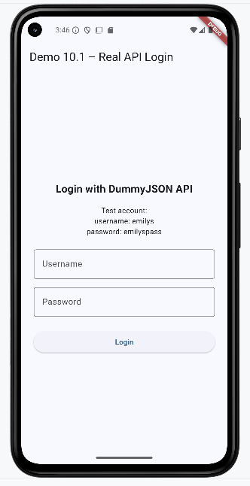
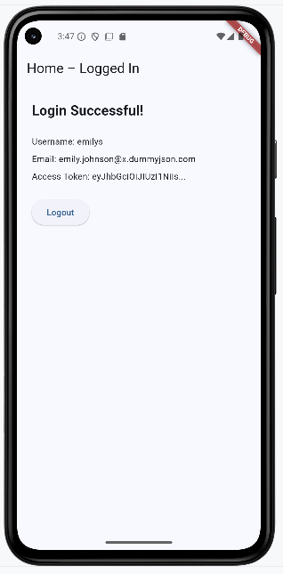
Demo1.1.R - Real API in Authentication
Description:
A real authentication demo using the DummyJSON API. The app sends login credentials via HTTP, receives an access token, handles errors, and navigates to the Home screen on success.
Key Steps
Build Login UI
Send Real API Request
Process Response
Navigate to Home Screen
Notes:
Why This Demo?
Demonstrates real API integration in Flutter
Mimics real production login flows
Shows how to handle networking, exceptions, and asynchronous programming
Prepares students for backend-connected mobile applications

Slide 14
Signup Flow Overview
Goal
Extend Demo 10.1 by adding a Signup screen
Reuse the same AuthService and error handling patterns
Allow users to create an account, then go back to Login
Flow
User taps “Create account” on the Login screen
Navigate to SignupScreen
User fills in: name, email/username, password, confirm password
Form validates input (field + cross-field rules)
App calls AuthService.signup(...)
On success → show success message → navigate back to Login
On failure → show API error (e.g., email already used)
Notes:
Emphasize: Demo 10.2 is not a new app, it is a natural extension of Demo 10.1. Same architecture, new flow.

Slide 15
Signup API Integration (Reuse AuthService)
Backend Integration Pattern
Login and Signup share the same service layer: AuthService
Add a new method:
Future<void> signup(SignupRequest dto);
Relation to Demo 10.1
Demo 10.1 → AuthService.login(...)
Demo 10.2 → same AuthService, just add signup(...)
UI uses the same error handling + loading patterns as login
Steps
Build a DTO (data object) for signup: name, email/username, password
Send POST /signup (or equivalent) to backend
Parse JSON response
Handle common errors:
Duplicate email / username
Weak password
Invalid data
Notes:
Highlight the idea of one shared service class for all auth-related methods (login, signup, logout, etc.).

Slide 16
Password Validation Rules (Used in Signup Form)
Field-level rules
Minimum 6–8 characters
At least 1 uppercase letter
At least 1 number
No leading / trailing whitespace
Form-level rules
“Password” and “Confirm Password” must match
Show clear, friendly error messages
UX Tips
Show validation before sending request to backend
Use inline error text below fields
Disable “Create account” button when form is invalid or loading
Relation to Previous Modules
Reuse patterns from Module 7 – Forms & Validation
Now applied in a real Signup scenario
Notes:
Explain that good validation reduces load on backend and improves UX.

Slide 17
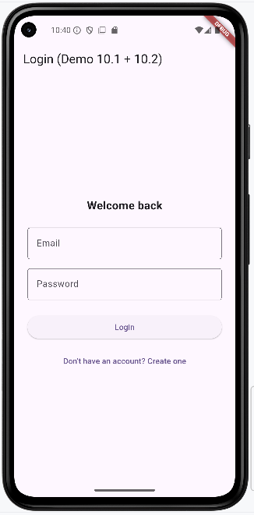
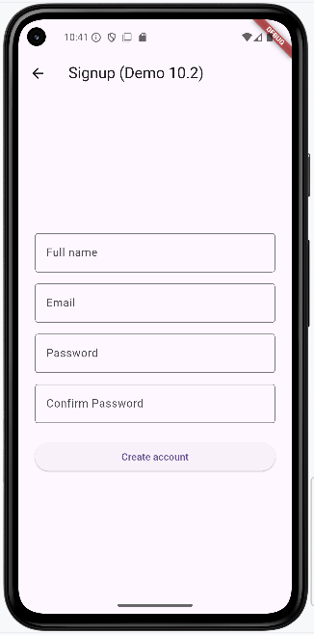
DEMO 10.2 — Signup Flow Implementation
What this demo adds on top of Demo 10.1
New SignupScreen with:
Name
Email/username
Password
Confirm password
New method in AuthService: signup(...)
Navigation between Login ↔ Signup
Demo Features
Validated signup form
Loading state while sending request
Display backend error (e.g. “Email already exists”)
On successful signup → show a success message and return to Login screen
Notes:
Explain clearly which parts are reused from Demo 10.1 (Form pattern, error handling, service class) and which parts are new (extra fields + cross-field validation + signup() API).

Slide 18
Understanding User Session
What is a Session?
A session represents the authenticated state of a user.
It typically includes:
Access token
User profile
Token expiry timestamp
How a session starts
User logs in (Demo 10.1)
App receives token
App stores token locally (SharedPreferences)
App restores token automatically next time (Demo 10.3)
How a session ends
Logout
Token expired
Force logout from server (401 Unauthorized)
Notes:
Explain that session management is required for every real mobile application that needs login.

Slide 19
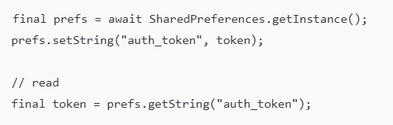
Persisting Session with SharedPreferences
Why store the token locally?
Keep user logged in between app restarts
Faster startup → auto skip login screen
Required for protected APIs
Session Logic
If token exists → user is authenticated
If missing/expired → navigate to LoginScreen
Code example
Notes:
This is where Demo 10.3 extends Demo 10.1 and 10.2.

Slide 20
Auto Login Flow (SPLASH → LOGIN/HOME)
Flow
Start SplashScreen
Load token from SharedPreferences
If token exists → go to Home
If no token → go to Login
HomeScreen allows Logout (delete token)
Flow Diagram:
Splash → (has token?) → Home / Login
Notes:
Demo 10.3 will implement the full auto-login + logout behaviors.

Slide 21
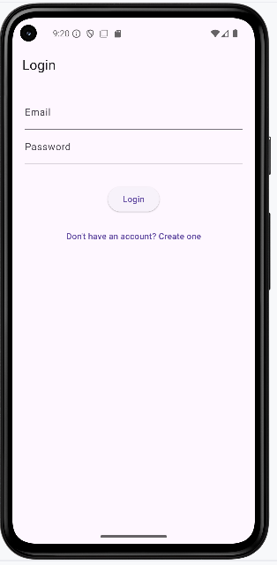
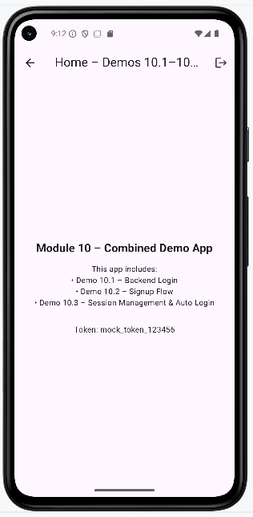
DEMO 10.3 — Auto Login + Logout Implementation
Description
Based on Demo 10.1 (Backend Login) and Demo 10.2 (Register).
Upon successful login, save the auth_token app to SharedPreferences.
The next time you open the app, the token checks for SplashScreen:
With token → go straight to Home (auto login).
Without token → go back to Login screen.
The Logout button on Home deletes the token, forcing the user to log in again next time.
Notes:
Highlight that Demo 10.3 is the first “full authentication cycle” demo
Files:
splash_screen.dart
auth_service.dart (extended with token persistence)
login_screen.dart (writes token)
home_screen.dart (logout clears token)

Slide 22
Test Scenarios for Demo 10.3
Scenario | Steps | Expected Result
1. First Login & Session Creation | Open the app → Login screen appears. Enter valid credentials (demo@test.com / 123456). Tap Login. | • User is navigated to Home – Demos 10.1–10.3.• Token is displayed (e.g., mock_token_123456).• Token is saved to SharedPreferences.
2. Auto Login (App Relaunch) | Close the app completely (remove from Recent Apps). Reopen the app from the launcher icon. | • Login screen is skipped.• SplashScreen loads token.• User is taken directly to Home with the same token displayed.
3. Logout & Session Clearing | From Home, tap the Logout icon. App returns to Login screen. Close and reopen the app. | • User stays on Login screen (auto-login disabled).• Token is removed from SharedPreferences.• Must log in again to access Home.

Slide 23



What is Firebase Authentication?
Firebase Authentication is a cloud-based identity platform that provides:
Secure and scalable login
Google, Apple, Facebook sign-in
Email/password authentication
Automatic session persistence
Built-in token refresh
Industry usage: e-commerce, travel, fintech apps
Why we introduce Firebase here?
Easier identity management than building your own backend
Industry standard for mobile apps
Used in modern e-commerce, booking, social apps

Slide 24
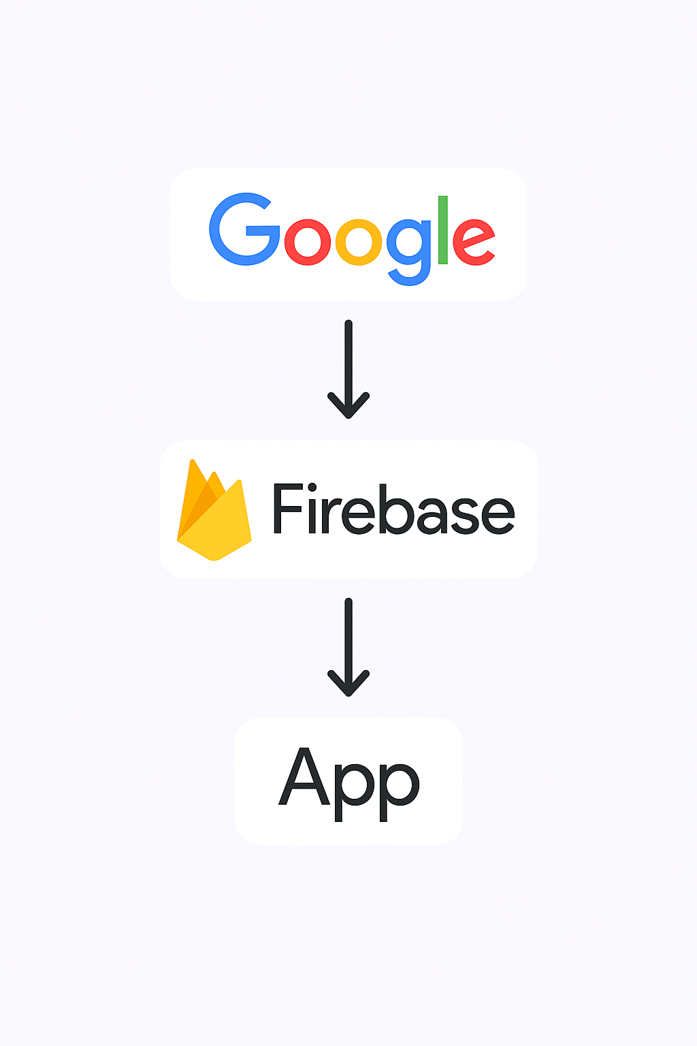
Google Sign-In Authentication Flow
Flow:
User taps Sign in with Google
Google account chooser appears
Google issues OAuth tokens
Convert to Firebase credential
Firebase signs in the user
App receives Firebase User object
Navigate to Home
Key Idea:
Firebase handles identity → our app only handles UI + navigatio

Slide 25
Required Configurations
Before coding Google Sign-In, the following must be configured:
Create Firebase Project
Add Android App (correct package name)
Add SHA-1 + SHA-256 fingerprints
Download and place google-services.json → android/app/
Add dependencies:
firebase_core
firebase_auth
google_sign_in
Enable Google Sign-In in Firebase Console
Notes:
Full detailed setup is in Firebase Setup Guide.

Slide 26
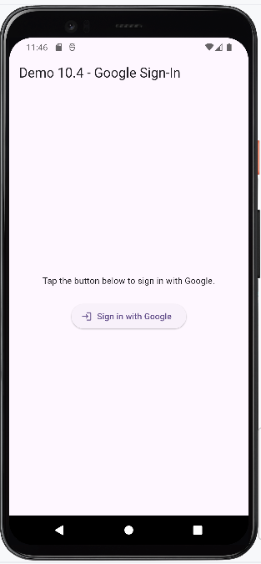
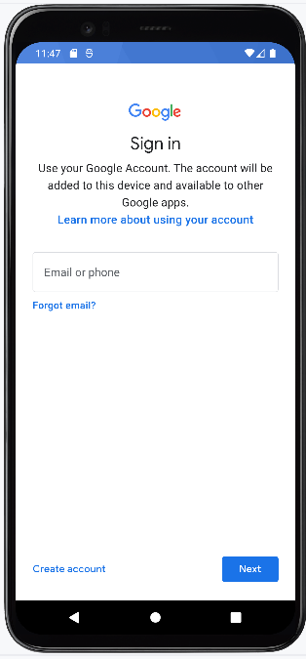
Demo 10.4: Google Sign-In (Overview)
google_sign_in_button.dart
google_profile_screen.dart
This demo demonstrates:
Google Sign-In (FirebaseAuth)
Display user profile (photo, email, name)
Persist login automatically
Logout from Firebase & Google
Files Used:
firebase_auth_service.dart
google_sign_in_button.dart
google_profile_screen.dart
main.dart configuration update
Notes:
Outcome:
Students can integrate Google login into any Flutter app.

Slide 27
Common Errors & Fixes
Error | Cause | Fix
Google Sign-In screen does not appear | Missing SHA-1 | Add SHA-1 → rebuild app
“DEVELOPER_ERROR” | Wrong package name | Ensure package name matches Firebase
Firebase initialization error | Missing google-services.json | Place file inside /android/app/
App crashes at launch | Missing Gradle plugin | Add com.google.gms.google-services
Login returns null | Emulator lacks Google Play Services | Use emulator with Play Store or real device

Slide 28
What is a Notification?
Notifications in Mobile Applications
A notification is a system-level message displayed outside the app UI.
It allows the app to inform users about important events.
Notifications improve user engagement and awareness.
Examples:
Login success
Account activity alerts
Reminders

Slide 29
Local vs Push Notification
Local Notification | Push Notification
Triggered by the app | Sent from a server
No internet required | Internet required
No backend needed | Requires backend
Simple to implement | More complex
Notes:
Focus in this demo: Local Notification

Slide 30
Why Notifications After Authentication?
Notifications in Authentication Flow
Notifications are commonly used after important user actions such as:
Successful login
Account verification
Password reset
Example:
“Login successful. Welcome back!”
Purpose:
Connect notifications with real application workflows.

Slide 31
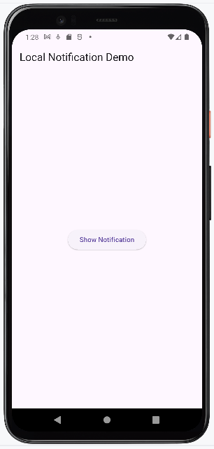
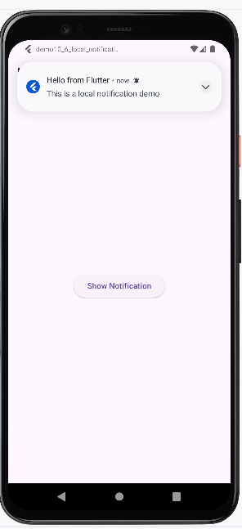
Demo 10.5: Local Notification Flow
Objective
Integrate local notifications in a Flutter application
Trigger a notification after a successful login
Keep notification logic separate from authentication logic
Step 1 – Setup Notification Service
Initialize plugin
Configure Android settings & permission
Step 2 – Trigger Notification After Login
Call notification logic
System displays notification
Notes:
In the real app, we call NotificationService.show() right after login() succeeds.
Here, we trigger it manually with a button for demonstration.

Slide 32
Best Practices & Patterns for Authentication
Security
Hash & salt passwords (server-side).
Never store raw tokens → use secure storage.
Always use HTTPS.
User Experience
Clear and friendly error messages.
Show loading indicators for all network calls.
Support auto-login with persisted session.
Architecture Patterns
AuthService (Singleton) separating UI from logic.
Standard flow: Splash → Login → Home.
Use pushReplacementNamed() to prevent navigating back to Login.
Error Handling
Wrap API calls in try/catch.
Display errors gracefully (Snackbar / inline text).
Notes:
Highlights how real apps design secure, maintainable, and user-friendly authentication flows.

Slide 33
Summary
In this module, students learned:
Core concepts of authentication, authorization, sessions, and JWT tokens
How to design and validate login and signup forms in Flutter
How to implement authentication using:
Mock backend service (Demo 10.1)
Real REST API integration (Demo 10.2 – DummyJSON)
How to persist user sessions and implement auto-login & logout using SharedPreferences (Demo 10.3)
How to integrate Firebase Authentication and Google Sign-In (Demo 10.4)
(Optional) How to integrate local notifications to enhance user experience after key actions (Demo 10.5)

Slide 34
References
Mastering Flutter 2025: Learn to Develop Flutter Apps, Kevin Moore, Packt Publishing. Chapter 9, 10, 12, 17, 19
Flutter Documentation – Authentication: https://docs.flutter.dev
Firebase Authentication Documentation: https://firebase.google.com/docs/auth
SharedPreferences Flutter Plugin: https://pub.dev/packages/shared_preferences
Path Provider Plugin: https://pub.dev/packages/path_provider
DummyJSON Authentication API: https://dummyjson.com/docs/auth
Flutter Local Notifications Plugin: https://pub.dev/packages/flutter_local_notifications

